Slide 2
SQL Server Virtualization and Consolidation
Des FitzGerald
Sylvio Hellmann
Premier Field Engineering
Microsoft Corporation

Slide 3
Agenda
Introduction
Virtualization
Consolidation
What are the top database initiatives you are currently pursuing for your enterprise databases?
Based on research published in a recent Forrester Consulting report( June 2008 “The Forrester Wave™: IT Consolidation Consultancies, Q2 2008” )
Database standardization | 43.9%
Clustering and virtualization | 41.2%
Automate database administration | 38.5%
Database consolidation | 37.2%
Database archiving (information life-cycle management) | 33.1%
Notes:
Stress that the introduction to PFE and Me will take at most 2 minutes……

Slide 4
Introduction
What is the PFE Group
Notes:
Just take 2 minutes to introduce myself and explain with the help of the slides what the PFE group within Microsoft does and what we offer.

Slide 5
What is Premier Field Engineering?
Premier Field Engineering is part of the Microsoft Premier Organization and we are working together with Premier Customers around the world in all product technology areas
We offer support for all business sizes
Small/medium businesses
Several hundred employees
Very large enterprises
Boeing, Wal-Mart, U.S. Federal and other Government organizations around the world.
Hundreds of thousands of seats
Service providers, telecoms
Many millions of users
Notes:
We are the onsite team of product specialists who work together with premier customers around the world to deliver both pro-active as well as re-active support for a whole host of Microsoft Technologies.
We work with companies ranging in sizes from a couple of hundred users and servers to very large organizations with hundreds of thousands of servers and users.
We are the eyes and ears of the product groups in the sense that we see first hand on the operating floor how the Microsoft technology products such as SQL Server are being used and what issues are being seen.

Slide 6
What is Premier Field Engineering?
Transactional as well as Dedicated Support.
Critical Situation resolution
Workshops and Training
Notes:
We offer both transactional (for short term) and Dedicated (for long term) support. A dedicated engineer can be onsite at a customer for longer term engagements.
We offer onsite technical expertise to resolve critical business issues relating to Microsoft products.
We also offer pro-active offerings to reduce the occurrence of critical situations such as trainings and workshops on Microsoft Technologies.

Slide 7


Where are we based?
Asia
APAC
India
Japan
Greater China
EMEA
Americas
Central & Eastern Europe
France
Germany
MEA
UK
Western Europe
Canada
United States:
Latin America
Fast Facts
Located in more than 50 Countries
40%/60% Dedicated/Transactional
7

Slide 8
What do we offer in terms of SQL Server?
Reactive support for Critical SQL Server Issues
Risk and Health Assessment for Microsoft SQL Server
WorkshopPlus
SQL Server 2000: Performance Tuning and Optimization
SQL Server 2005: Performance Tuning and Optimization
SQL Server 2005: Desired Configuration Monitoring
SQL Server 2005: Administration
Workshops
SQL Server 2008 Administration
SQL Server High Availability 2005 + 2008
Migration Workshop
Reporting Services 2005 + 2008
Analysis Services 2005 + 2008
Integration Services 2005 + 2008
+ More…….

Slide 9
How do I find out more about PFE?
Ask your TAM (Technical Account Manager)
Ask me or any of my colleagues here from PFE

Slide 10
Who Am I?
Des FitzGerald
Irish SQL Server PFE based out of Munich.
SQL Server DBA/Consultant for 11 years.
First started using SQL Server 6.5
Worked in Blue Chip, Banking and Pharma industries before Microsoft.
Embarrassing Fact:- I used to work with Oracle but quickly moved to SQL Server. ☺

Slide 11
SQL Server Virtualization
Des FitzGerald
MSSQL Server - Premier Field Engineer
Microsoft Corporation
dfitzger@microsoft.com
Notes:
Just take 2 minutes to introduce myself and explain with the help of the slides what the PFE group within Microsoft does and what we offer.

Slide 12
Questions which will be answered today?
Should I really virtualize a production SQL Server?
Is SQL Server supported running in a Virtual Environment?
How performant is a Virtual SQL Server?
What are the different disk options for a Virtual SQL Server?
How does SQL Server Licensing work on a Virtual SQL Server?
What about Clustering on a Virtual Platform?

Slide 13
Questions which will not be answered today?
What is Virtualization?
Which is better VMWare ESX or Microsoft Hyper-V?
How much faster/slower will my database application run once on a Virtual SQL Server?
When is Windows 2008 R2 (Hyper-V R2) being released?

Slide 14
Agenda
Overview
Really Production Ready?
Storage Considerations
SAN Disk Considerations
High Availability / Disaster Recovery
Limitations
Licensing
Notes from the Field / Recommendations
Notes:
Stress that the introduction to PFE and Me will take at most 2 minutes……

Slide 15
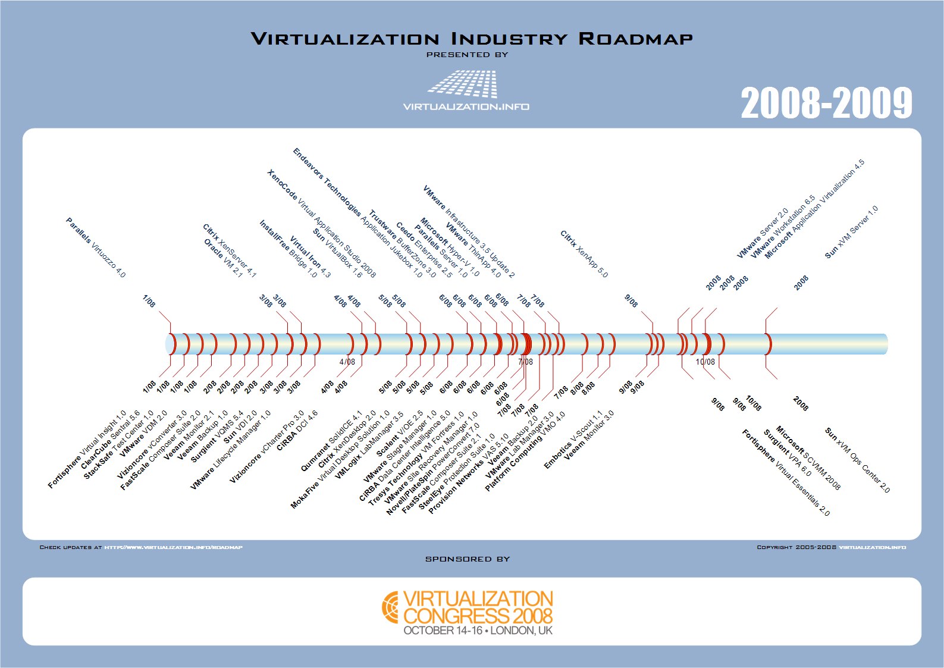
Virtualization Vendors and Platforms

Slide 16
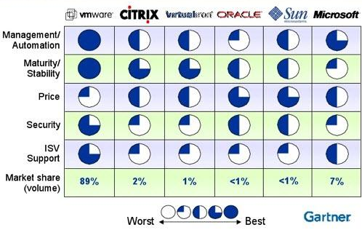
Virtual Machine Environment Competitive Comparisons

Slide 17
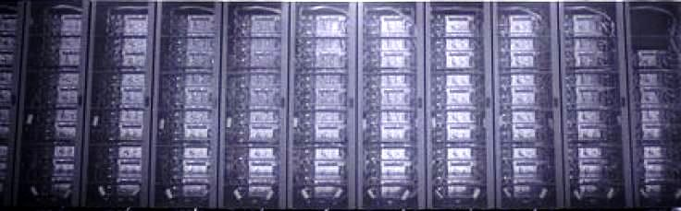
Windows Server Virtualization Validation Program
Microsoft
Cisco Systems, Inc.
Citrix Systems, Inc.
Novell, Inc.
Oracle, USA Inc.
Red Hat, Inc.
Riverbed Technology, Inc.
Sun Microsystems
Unisys Corp.
Virtual Iron Software
VMware, Inc.
http://windowsservercatalog.com/svvp.aspx?svvppage=svvp.htm
Notes:
These companies who supply server virtualization software to the marketplace have formally committed to participate in the Server Virtualization Validation Program. Microsoft is working with them to validate their solutions as platforms for Windows Server 2008.

Slide 18
Really Production Ready for SQL Server?
No longer virtualized Hardware
Easier to maintain than physical hardware
Fast performance
Cost effective
Reduces downtime
Microsoft Internal Project
Physical – Virtual
Fully supported on multiple virtualization platforms http://support.microsoft.com/kb/956893/en-us
Clustering of Guest OS is NOT supported (yet)
Notes:
In the older days of Virtualization and virtual server platforms such as Virtual PC and Virtual Server etc. The main hardware layer such as CPU was also virtualized– the actual server hardware was not used as a basis for the virtual machine or Guest Servers. This led to performance issues as the physical host servers were powerful machines but the virtual guest servers sitting on these were underpowered due to this virtual hardware layer. This stopped applications such as Exchange and SQL Server from using this technology in anything but test environments.
Nowdays most of the physical hardware is passed through directly to the virtual machines – so that for example the CPU resource is directly accessible from within the guest server this leads to much better performance for resource intensive applications such as SQL Server and means in turn that production systems could run off virtualized servers.
The maintenance of the virtual servers is also easier than that of physical servers in the case of the
With todays virtualization technology there is no longer in most normal situations and systems a performance penalty in terms of moving to a virtual SQL Server.
The cost benefits of virtualizing SQL Server are multiple – licensing discussed later – hardware costs – power consumption – datacentre space.
With technology such as VMWare VMotion and Microsoft’s Live Migration the downtime needed by a SQL Server can be greatly reduced by moving to a virtual server solution as a physical hardware failure can be mitigated utilizing such technologies – also performance can be improved using these technologies as well.
Restart times are also normally faster on Virtualized SQL Servers –
Details of Microsoft`s internal project for moving some SQL Servers to Hyper-V
Previously SQL Server was not supported on Virtual Server / Virtual PC etc due to limitations of hardware virtualization as discussed. It is now supported however on Hyper V as well as VMWare – Clustering is not yet supported but it is coming – complex due to the amount of different options (guest clustering / host clustering or a mix or example)

Slide 19
Storage Considerations
Options for disk management in Virtualized SQL Servers
Pass Through Disk (Raw Device Mapping)
Virtual Hard Disks (VHD, VMHD etc.)
iSCSI
Pass through vs. Virtual HD
Passthrough disks will provide optimal performance
Bypasses the NTFS layer at the root
Requests are passed to root over the VMBus directly to the VSP and down the device stack
Observed minimal overhead with fixed length VHD
VHD likely will provide more flexibility
Use separate virtual SCSI controllers per VHD is the most optimal configuration for VHD
Dynamic vs. Fixed VHD’s
Fixed: space is reserved and allocated at creation
Dynamic: space is allocated on demand
Significant write penalty and not recommended for SQL Server workloads
Performance
Recoverability
Notes:
The most common question is whether to use Pass Through or Virtual Hard Disks – performance metrics show us that there is little difference between one or the other until the disk IO system is heavily used in very large SQL Servers for example..
Pass through removes the need to go to the host servers disk system at all and allows the disk to be directly presented to the virtual server, this means that there is no need to go to the Virtualized I/O Layer on the host and so it is slightly faster, however the monitoring of the performance on pass through disks is harder as this will require the help of the storage team in the case of SAN storage.
Virtual Hard Disks should be set to a pre-determined size and not set to auto-grow as this has a serious effect on performance.
Correct disk offsets (1024K) and block sizes (normally 64K) should be set on the disks being used by SQL Server to ensure optimal performance. Here the interesting question of virtual hard disks comes up – should the offset and block size be important on the VHD so when formatting the virtual hard disk or only on the physical disk on the host server storage device????? – the answer is that it should be done on all levels if using VHD and also again make sure no auto grow enabled on VHD…….
The backup of the Virtual hard disk files from a host system makes the recovery of a virtual server using this storage method easier than recovering a VM using Pass Through disk

Slide 20
SAN Disk Considerations
Vendors and technologies
Correct LUN configurations
Correct Zoning
Performance
Storage Teams
Plan - Plan – Plan
Notes:
Many different vendors each with their own technologies – research……
Technologies such as SRDF (Shadow Copy) can impact performance but may be a business requirement for DR reasons.
The most important point is that like a physical SQL Server the SAN disk configuration for a virtual SQL Server must also be carefully considered and planned.
LUNS should be dedicated and zoned correctly for the purpose they are intended – do not rely on the old “but we have tons of Cache” line from the SAN storage team.
Avoid virtualizing servers that have (and utilize) more than 2 HBAs.
Performance is paramount – RAID Groups should be defined and a base line for cost/performance should be established at the beginning of the project.
Work together with the Storage teams – make them aware of your concerns and thoughts but do not dictate to them – agree on a constant Read/Write performance I/O value and allow them to facilitate this requirement. Be carefull that they are dedicating the disk resources presented to you though and you are not sharing your disk with Exchange for example.
Again make sure to get this right at the beginning as later on it will be very difficult if not impossible to change.

Slide 21
High Availability / Disaster Recovery
Virtualization is NOT a DR solution
Can help in minimizing downtime of a critical SQL Server
Clustering is NOT supported so this HA solution is not at the moment a virtualization strong point
VMWare Vmotion and such technologies can help in better mitigating hardware failures or overloads
Notes:
Virtualization is not a replacement for a good disaster recovery plan however it can make recovery easier.
The backup of guest VM’s is easier than physical servers and the ability to find a host and place the backed up file(s) on this host and get the system back up and running is much faster than finding and rebuilding a physical server.

Slide 22
Limitations
Hardware limits on Virtual SQL Servers
Sufficient processor resources
max. 4 with Windows Server 2008
max. 2 with Windows Server 2003
max. 1 for other OS
Memory
Disk resources
Heavy OLTP workloads still too much for virtualized SQL Servers
Virtual Network Card issues and limits
Another additional layer of complexity
Notes:
There are hardware limits for virtual machines such as maximum CPU, RAM and disk size allowed which need to be considered when looking at virtualiziing SQL Server.
Heavy OLTP systems can stretch even dedicated physical SQL Servers to their limits so they are clearly out of the scope of SQL Server virtualization.
The Virtual NIC’s are limited on certain vendors virtualization platforms so this needs consideration in the case of multiple NIC’s needed for specific operations on the SQL Server – such as backups etc.
When troubleshooting performance issues on the SQL Server the additional virtualization layer can become confusing and complex, take for example disk issues on a virtual hard disk, are the issues on the virtual hard disk or on the underlying hard disk on the host where the virtual hard disk is sitting?

Slide 23
Licensing
SQL Server license requirements are the same as for physical box
SQL Server Processor license required for each physical or virtual CPU
Seat license / CAL for connections to virtual SQL Server as with Physical SQL Server
Single Windows License (2003R2/2008) required for the Host Server if using Standard Edition (1 VM), Enterprise Edition (up to 4 VM’s) or Datacentre Edition (unlimited). No separate License required for the VM OS
VM Licenses in above point are backward compatible as well so if you have a W2008 Enterprise License on the host server you can install Windows Server 2000/2003 Enterprise edition on the guest VM
Notes:
So the windows licensing is as follows, if I have a server which I wish to use as a Virtual Host and I install the Enterprise or Datacenter editions of Windows Server 2003 R2 or Windows Server 2008 on it I can install a further 4 virtual machines using the same OS / or lower if I am running Enterprise Edition or unlimited guest virtual machines in the case of datacenter edition.
AND YES VMWARE ALSO NOT JUST HYPER-V or VS.

Slide 24
Notes From the Field / Recommendations
No huge performance difference between Pass Through and Virtual Hard Disks so recommend using Virtual Hard Disks for ease of use and monitoring unless the system is highly transactional in which case probably not a good candidate for virtualization in the first place
Plan for growth on each SQL Server being virtualized as you do for physical SQL Servers – this helps to plan the disk subsystem correctly
When using Virtual Hard Disks (VHD, VMFS) then ensure that these disks are set and preconfigured to a size DO NOT use autogrow features
Notes:
Some of these recommendations are in general for SQL Server disk management and not just for Virtual SQL servers.

Slide 25
Notes From the Field / Recommendations
Correctly format the disks (whether VHD or pass through) correct block sizes and offset (not for W2008) should be set at all relevant levels to ensure optimal performance
Correctly zone the disks on the SAN side, dedicate spindles in the form of a LUN to an individual SQL Server and again dedicate separate LUNS for Data, Log, Backup and TempDB when possible
Pay attention to RAID Groups and RAID according to pre defined cost/performance values

Slide 26
Notes From the Field / Recommendations
Never believe the “Huge Cache” line from certain groups
Work together with the Storage teams to find best solutions and agree upon acceptable performance levels before hand
Patch Management can be difficult to coordinate on Virtual Servers – get the strategy correct to minimize unwanted downtime of SQL Server

Slide 27
Notes From the Field / Recommendations
Although SQL Server clusters can be setup in a virtual environment it is not supported and can have issues (heartbeat, Virtual NICs) so for anything but test DO NOT attempt
A production SQL Server is perfectly capable of being run in a virtual environment. It is being done on a large scale and also even in Microsoft – HOWEVER it is not the holy grail there are limitations.
Virtual SQL Servers save money and this may get you a bigger bonus or even save jobs ☺
Notes:
Your host’s CPU can change. Your server can get moved from a 2ghz box to a 3ghz box without warning
New features and new versions of virtualization software come out at a breakneck pace, and like any other software, it’s got bugs. A particularly nasty bug surfaced in VMware ESX v3.5 Update 2 - on a certain date, VMware users couldn’t power on their servers because the licensing was expired - even if it wasn’t
Performance monitoring is more complex.
Disk – Disk – Disk….
.

Slide 28
Microsoft Virtualization Solutions Microsoft Hyper-V
Sylvio Hellmann
MSSQL Server - Premier Field Engineer
Microsoft Corporation
sylvioh@microsoft.com
Notes:
Just take 2 minutes to introduce myself and explain with the help of the slides what the PFE group within Microsoft does and what we offer.

Slide 29
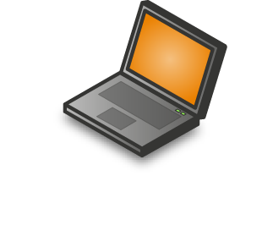




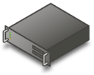












Microsoft Virtualization Solutions
A comprehensive set of virtualization products, from the data center to desktop assets – both virtual and physical – are managed from a single platform
Profile
Virtualization
Document Redirection
Offline files
Server/Desktop Virtualization
Presentation Virtualization
Management
Centralized Desktop
Desktop Virtualization
Application Virtualization
(Formerly SoftGrid)

Slide 30
What is Microsoft Hyper-V Server?
Microsoft Hyper-V Server
(HVS)
Hyper-V, feature of
Windows Server 2008
Microsoft Hyper-V Server
Hyper-V
Windows or Linux
Windows
or Linux
Windows
or Linux
Windows or Linux
Windows (parent partition)
Parent Partition
Windows hypervisor
Windows hypervisor
Hardware
Hardware
Contains Windows hypervisor and other components, including base kernel and driver technologies.
Available as a role in Server Core or full installation of Windows Server 2008

Slide 31















Hyper-V Architecture
Provided by:
OS
Hyper-V
Parent Partition
Child Partitions
ISV/IHV/OEM
Virtualization Stack
WMI Provider
VM Worker Process
SQL
SQL
SQL
VM Service
User Mode
Windows Server 2008
Windows Server 2003, 2008
Windows Server 2003, 2008
Windows Server 2003, 2008
Windows Kernel
Windows Kernel
Windows Kernel
Windows Kernel
VSP
VSC
VSC
VSC
VMBus
VMBus
VMBus
VMBus
Kernel Mode
Hyper - V
“Designed for Windows” Server Hardware
31
Notes:
VSP = Virtualization Service Providers
VSC = Virtualization Service Clients

Slide 32
Hyper-V Preinstall Checklist and Considerations
Use a server processor that supports hardware-assisted virtualization. There are two to choose from:
Inter VT
AMD virtualization (AMD-V)
Ensure that hardware-assisted virtualization and Data Execution Prevention (DEP) are present and enabled. (You can verify this in the BIOS setting.)
Run the Hyper-V server role on the root partition only of the Windows® operating system.
Set any disks that will be configured as pass-through disks for the guest virtual machine as offline in root partition using DISKPART or Volume Manager.
Ensure that the integration components (“enlightenments”) are installed on the guest virtual machine.
Use a network adapter instead of a legacy network adapter when configuring networking for the virtual machine.
Avoid emulated devices for SQL Server deployments when possible. These devices can result in significantly more CPU overhead when compared to synthetic devices.

Slide 33
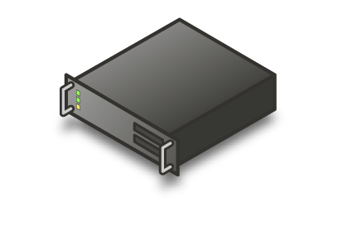
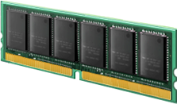


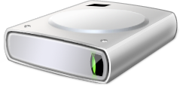
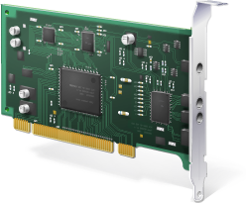
Hyper-V Hardware Limits
Physical Host
2 TB
16 cores
No limit
(500 rec.)
64 GB
260 disks
2 TB each
1-4 VPs
8 NICs
Virtual Guest
Notes:
Knowing the support limits of various VM parameters can help you plan your “consolidation ratio”, which is the number of VMs that can be run on a specific host.
Each parent can have up to 16 logical processors or cores. With the 8:1 overcommit ratio, this means a parent can support up to 128 virtual processors.
Hyper-V does not set a limit on the amount of RAM in a parent, so the limit is 2 TB, the same as Windows Server 2008
Hyper-V also does not set a limit on the number of VMs that can be created, but the recommended maximum is 500. Of course, those 500 could not all be running at the same time due to other resource constraints.
A single VM can have up to four processors, depending on the guest OS.
A single VM can have up to 64GB of RAM.
A VM can have up to 4 SCSI controllers with 64 disks per controller and 2 IDE controllers with 2 disks per controller.
A VM can have up to 8 enlightened NICs and 4 emulated. For performance reasons, it is best to use enlightened NICs whenever possible.
A VM can have up to 50 snapshots.

Slide 34
Hyper-V Pricing and Licensing
Microsoft Hyper-V Server is a free download available from http://www.microsoft.com/hyper-VServer
No CALs are required for Microsoft Hyper-V Server
Every guest OS instance must be licensed and CALs are still required for the guest OS
Customers who want flexible virtualization rights should use Windows Server 2008
Windows Server 2008 Std Edition
1 VM instance included
Windows Server 2008 Enterprise Edition
4 VM instances included
Windows Server 2008 Datacenter Edition
Unlimited VM instances per processor license

Slide 35
Hyper-V Best Practices
Apply the best practices for optimizing performance for Hyper-V virtual machines
Provision and manage virtual machines just like physical machines
Avoid over-provisioning the physical hosting environment as you start deploying virtual machines
Do not assume that you can virtualize all server roles and workloads.
Test and monitor all server workloads
Standardize and automate the configuration and deployment of the majority of virtual machines
Carefully consider both application features and Hyper-V functionality when designing virtual machine deployments
Notes:
Apply the best practices for optimizing performance for Hyper-V virtual machines. Regardless of the server workload that you deploy on a virtual machine, there is a consistent set of recommendations that you should apply for all virtual machines, including:
Use Windows Server 2008 as the guest operating system whenever possible.
Install the virtual machine integration components.
Avoid over-committing CPU processor cores on heavily utilized virtual machines.
Use pass-through disks or fixed virtual disks attached to SCSI controllers for best performance.
Provision and manage virtual machines just like physical machines. In almost all cases, virtual machines require the same hardware resources as are required to run the server workload on a physical machine. The benefit of deploying virtual machines is that you can deploy the right level of hardware easily. For example, if the server workload is using only a fraction of a physical computer's resources, you can assign less hardware to the virtual machine without affecting server performance.
Avoid over-provisioning the physical hosting environment as you start deploying virtual machines. When you design the physical hosting environment, ensure that you allow some excess capacity in case you need to add more capacity to some of the virtual machines. It is much easier to increase the hardware available to a virtual machine if you have extra resources available.
Do not assume that you can virtualize all server roles and workloads. For each new server workload that you consider virtualizing, make sure that you understand all performance characteristics of the workload. In some cases, it may make more sense to deploy a physical server and use the application consolidation options rather than deploying the workload on a virtual machine.
Test and monitor all server workloads. If you decide to deploy a new server workload on a virtual machine, ensure that you test the workload before deploying the virtual machines in a production environment. As you deploy the server, monitor the server performance to identify bottlenecks as soon as possible.
Standardize and automate the configuration and deployment of the majority of virtual machines. As Microsoft IT solidifies the hardware and software requirements for a variety of server workloads, it is working on developing System Center Virtual Machine Manager templates to deploy the virtual machines. Microsoft IT wants to develop templates and automated processes to deploy 80 percent of all virtual machine requests without any direct administrator involvement.
Carefully consider both application features and Hyper-V functionality when designing virtual machine deployments. For example, both SQL Server and Exchange Server 2007 provide built-in functionality to enable high availability. Hyper-V also provides high-availability options. When choosing between the two options, ensure that you understand the benefits and disadvantages of each option.

Slide 36
Hyper-V Server 2008 R2
Sylvio Hellmann
MSSQL Server - Premier Field Engineer
Microsoft Corporation
sylvioh@microsoft.com
Notes:
Virtualization is a major part of today’s data centers. The operating efficiencies offered by virtualization allow organizations to dramatically reduce operational effort and power consumption.
Windows Server 2008 R2 provides the following virtualization types:
Client and Server Virtualization Provided by Hyper-V
Hyper-V virtualizes the system resources of a physical computer. Computer virtualization allows you to provide a virtualized environment for operating systems and applications. When used alone, Hyper-V™ is typically used for server computer virtualization. When Hyper-V is used in conjunction with Virtual Desktop Infrastructure (VDI), Hyper-V is used for client computer virtualization.
Windows Server 2008 server virtualization using Hyper-V technology has been an integral part of the operating system. Windows Server 2008 R2 introduces a new version of Hyper-V. Hyper-V in Windows Server 2008 R2 includes three core areas of improvement for creating dynamic virtual data centers:
Increased Availability for Virtual Data Centers
One of the most important aspects of any data center is providing the highest possible availability for systems and applications. Virtual data centers are no exception to the need for consolidation, high availability and most of all sophisticated management tools.
Hyper-V in Windows Server 2008 R2 includes the much-anticipated Live Migration feature, which allows you to move a virtual machine between two virtualization host servers without any interruption of service. The users connected to the virtual machine being moved might notice only a slight slowing in performance for a few moments. Otherwise, they will be unaware that the virtual machine was moved from one physical computer to another.
Live Migration Support through Cluster Shared Volumes
Live Migration uses the new Cluster Shared Volumes (CSV) feature within Failover Clustering in Windows Server 2008 R2. The CSV volumes enable multiple nodes in the same failover cluster to concurrently access the same Logical Unit Number (LUN). From a VM’s perspective, each VM appears to actually own a LUN; however, the .vhd files for each VM are stored on the same CSV volume.
Improved Cluster Node Connectivity Fault Tolerance
Because of the architecture of CSV, there is improved cluster node connectivity fault tolerance that directly affects VMs running on the cluster. The CSV architecture implements a mechanism, known as dynamic I/O redirection, where I/O can be rerouted within the failover cluster based on connection availability.
Enhanced Cluster Validation Tool
Windows Server 2008 R2 includes a Best Practices Analyzer (BPA) for all major server roles, including Failover Clustering. This analyzer examines the best practices configuration settings for a cluster and cluster nodes.
Improved Management of Virtual Data Centers
Even with all the efficiency gained from virtualization, virtual machines still need to be managed. The number of virtual machines tends to proliferate much faster than physical computers because machines typically do not require a hardware acquisition. Therefore, management of virtual data centers is even more imperative than ever before. Windows Server 2008 R2 includes the following improvements that will help you manage your virtual data center:
Reduced effort for performing day-to-day Hyper-V administrative tasks by using the Hyper-V Management Console.
Enhanced command-line interface and automated management of Hyper-V administrative tasks by using PowerShell cmdlets.
Improved management of multiple Hyper-V servers in a virtual data center environment by using System Center Virtual Machine Manager 2008.
Simplified Method for Physical and Virtual Computer Deployments
Historically, different methods have been used to deploy operating systems and applications to physical and virtual computers. For virtual computers, the .vhd file format has become a de facto standard for deploying and interchanging preconfigured operating systems and applications. Hyper-V in Windows Server 2008 R2 supports two important updates concerning .vhd files.
Administrators can now add and remove vhd files, as well as pass-through disks attached to a virtual SCSI controller on a running VM, without requiring a reboot. This offers more flexibility when it comes to handling storage growth needs without requiring additional downtime. It also provides more flexibility in data center backup scenarios as well as new scenarios in complex Exchange and SQL Server deployments.
Windows Server 2008 R2 supports the ability to boot a computer from a .vhd file stored on a local hard disk. This allows you to use preconfigured .vhd files for deploying virtual and physical computers. This helps reduce the number of images you need to manage and provides an easier method for test deployment prior to deployment in your production environment.
Increased Performance and Hardware Support for Hyper-V Virtual Machines
Hyper-V in Windows Server 2008 R2 adds new performance enhancements that increase virtual machine performance and power consumption. Hyper-V now supports Second Level Address Translation (SLAT), which uses new features on today’s CPUs to improve VM performance while reducing processing load on the Windows Hypervisor. New Hyper-V VMs will also consume less power by virtue of the new Core Parking feature implemented in Windows Server 2008 R2.
Improved Virtual Networking Performance
The new Hyper-V leverages several new networking technologies contained in Windows Server 2008 R2 to improve overall VM networking performance. Two key examples are TCP Offload support and the use of Jumbo Frames. TCP Offload allows a VM to dump its network processing load onto the NIC of the host computer. This works the same as in a physical TCP Offload scenario, Hyper-V™ extends this functionality into the virtual world. This benefits both CPU and overall network throughput performance, and it’s fully supported by Live Migration.
Like TCP Offloading, support for Jumbo Frames was also introduced with Windows Server 2008. Hyper-V™ in Windows Server 2008 R2 simply extends this capability to VMs. So just like in physical network scenarios, Jumbo Frames add the same basic performance enhancements to virtual networking. That includes up to 6 times larger payloads per packet, which improves not only overall throughput but also reduces CPU utilization for large file transfers.
Presentation Virtualization
This type of virtualization provided by Remote Desktop Services’ RemoteApp (see below for more information on the Terminal Services’ name change in Windows Server 2008 R2) virtualizes a processing environment and isolates the processing from the graphics and I/O, making it possible to run an application in one location but have it be controlled in another.
Terminal Services makes it possible to remotely run an application in one location but have it be controlled and managed in another. Microsoft has evolved this concept considerably in Windows Server 2008 R2, and renamed Terminal Services to Remote Desktop Services (RDS) to better reflect these new features and capabilities. The goal of RDS is to provide both users and administrators with both the features and the flexibility necessary to build the most robust access experience in any deployment scenario.
To expand the Remote Desktop Services feature set, Microsoft has been investing in the Virtual Desktop Infrastructure, also known as VDI, in collaboration with our partners, which include Citrix, Unisys, HP, Quest, Ericom and several others. VDI is a centralized desktop delivery architecture, which allows customers to centralize the storage, execution and management of a Windows desktop in the data center. It enables Windows and other desktop environments to run and be managed in virtual machines on a centralized server. RDD and VDI addresses all these challenges with the following features:
Improved User Experience
For both VDI and traditional remote desktop services the quality of user experience is more important than ever before. The version of VDI and remote desktop services in Windows Server 2008 improves the end user experience through new Remote Desktop Protocol capabilities. These new capabilities, enabled with Windows Server 2008 R2 in combination with Windows 7, help make the user experience for remote users almost identical to local users.
Improved RemoteApp and Desktop Connections
New RemoteApp & Desktop Connection (RAD) feeds provide a set of resources, such as RemoteApp programs and Remote Desktops. These feeds are presented to Windows 7 users via the new RemoteApp & Desktop Connection control panel, and resources are tightly integrated into both the Start menu and the system tray. The improved RemoteApp and Desktop Connections features in Windows Server 2008 R2 and Windows 7 provide the following improvements:
Extends Remote Desktop Services to provide tools to enable VDI
Provides simplified publishing of, and access to, remote desktops and applications
Improved integration with Windows 7 user interface
Multimedia Redirection
True multiple monitor support
Audio Input & Recording
Aero Glass support
Direct X redirection
Improved audio/video synchronization
Language Bar Redirection
Task Scheduler
Improved RemoteApp and Desktop Management
While RAD improves the end-user experience, RAD also reduces the desktop and application management effort by providing a dedicated management interface that lets IT managers assign remote resources to users quickly and dynamically. Windows Server 2008 R2 includes the following RAD management capabilities to help reduce administrative effort:
RemoteApp & Desktop Connections control panel applet
Single administrative infrastructure
Designed for computers that are domain members and standalone computers
Always up to date
Single sign-on experience within a workspace
RemoteApp & Desktop Web Access
Improved RemoteApp and Desktop Deployment
Administrators faced with larger RAD deployment scenarios will also find additional management features in Windows Server 2008 R2’s Remote Desktop Services aimed at improving the management experience for all existing scenarios previously addressed by Terminal Services as well as the new scenarios available via RAD. These improved management features include:
PowerShell Provider
Profile Improvements
Microsoft Installer (MSI) compatibility
Remote Desktop Gateway

Slide 37
New Features
Live Migration
High Availability
New Processor Support
Second Level Address Translation
Core Parking
Networking Enhancements
TCP/IP Offload Support
VMQ & Jumbo Frame Support
Hot Add/Remove virtual storage
Enhanced scalability
Enhancements to SCONFIG

Slide 38
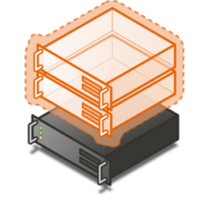


Quick Migration vs. Live Migration
(Windows Server 2008 Hyper-V)
Save state Virtual Machine
Create VM on the target
Write VM memory to shared storage
Swap Storage Connection
Move storage connectivity from source host to target host
Restore state & Run
Take VM memory from shared storage and restore on Target
Resume
(Windows Server 2008 R2 Hyper-V)
VM State/Memory Transfer
Create VM on the target
Live copy memory pages from the source to the target via Ethernet
Final state transfer and virtual machine restore
Pause virtual machine
Move final memory pages (small)
Resume
Host 1
Host 2
Host 1
Host 2

Slide 39

Live Migration
VM State/Memory Transfer
Create VM on the target
Move memory pages from the source to the target via Ethernet
Final state transfer and virtual machine restore
Pause virtual machine
Move storage connectivity from source host to target host via Ethernet
Un-pause & Run
Host 1
Host 2
Blue = Storage
Purple = Networking
Shared Storage

Slide 40
Migration & Storage
NEW Cluster Shared Volumes (CSV) CSV provides a single consistent file name space; All Windows Server 2008 R2 servers see the same storage
Easy setup; Uses NTFS
No reformatting SANs
Create one big data store
No more drive letter problems
Existing tools just work

Slide 41
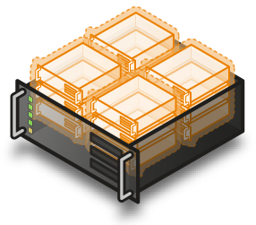
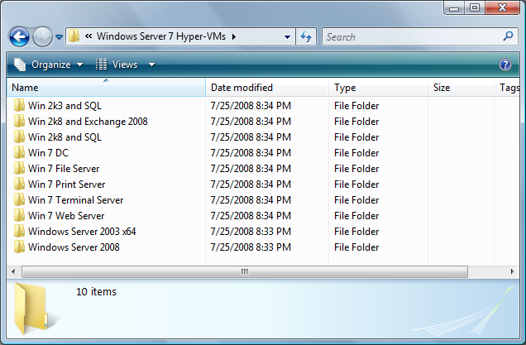

Cluster Shared Volumes
All servers “see” the same storage

Slide 42
Hyper-V Server R1 vs. R2
 | Microsoft Hyper-V Server 2008 | Microsoft Hyper-V Server R2
Processor Support | Up to 4 processors up to 24 LPs | Up to 8 processors Up to 32 LPs
Physical Memory Support | Up to 32 GB | Up to 1 TB
Virtual Machine Memory Support | Up to 32 GB total (e.g. 31 1 GB VMs or 5 6 GB VMs) | 64 GB of memory per VM
Live Migration | No | Yes
High Availability | No | Yes
Management Options | Free Hyper-V Manager MMC SCVMM | Free Hyper-V Manager MMC SCVMM R2

Slide 43
Why Hyper-V Server 2008 R2?
Extensive Hardware Support
Management
Plugs right into Active Directory
Consistent management experience
Production Ready
Live Migration
High Availability
High performance
Far better value than ESXi…

Slide 44
Additional References
Performance Tuning Guidelines for Windows 2008 Server (section on Hyper-V)
http://www.microsoft.com/whdc/system/sysperf/Perf_tun_srv.mspx
Running SQL Server 2008 in a Hyper-V Environment - Best Practices and Performance Recommendations
http://download.microsoft.com/download/d/9/4/d948f981-926e-40fa-a026-5bfcf076d9b9/SQL2008inHyperV2008.docx
VMWare SQL Server Workload
http://www.vmware.com/files/pdf/SQLServerWorkloads.pdf
Hyper-V Related BLOGS
http://blogs.msdn.com/tvoellm/
http://blogs.technet.com/virtualization/
http://blogs.technet.com/jhoward/
http://blogs.msdn.com/virtual_pc_guy/
http://blogs.technet.com/roblarson/default.aspx
http://blogs.msdn.com/mikekol/

Slide 45
SQL Server Consolidation
Des FitzGerald
MSSQL Server - Premier Field Engineer
Microsoft Corporation
dfitzger@microsoft.com

Slide 46
Agenda
Overview
Reasons for consolidation
Forms of Consolidation
Identifying potential consolidation candidates
Microsoft IT - SQL Server Consolidation
Consolidation Considerations / Observations

Slide 47
Consolidation Overview
SQL Server Consolidation is the process of identifying and reducing the number of SQL Server Instances or servers within an organization.
What do we mean by SQL Server consolidation what forms can it take?
Server Level
Database Level
Notes:
Server level is looking at our environment and identifying potential SQL Servers which are heavily under utilized and who’s databases could be consolidated to running on a shared SQL Server.
Database level is identifying databases sitting on SQL Servers in the enterprise due to legacy requirments such as SA password needs which could be brought to either a shared instance or a dedicated instance of SQL Server on a shared server.

Slide 48
Reasons for SQL Server Consolidation
Cost savings
Ease of Administration
Reduce Hardware
Move to newer technology
Notes:
There are huge cost savings to be made by decomissioning under-utilized SQL Servers and taking the databases hosted on these servers and moving them to a shared SQL Server.
Rack space, cooling, power, licensing and hardware costs can all be reduced by better understanding our SQL Server environment.
The less SQL Server installations in an environment the easier the administration of the environment is for DBA teams – less patching – less hardware issues etc.
Also by moving away from older database installations such as SQL Server 2000 to SQL Server 2005 or 2008 and even running these 2000 databases on the newer hardware and database system in 2000 compatibility mode the DBA is moving his/her skill sets onwards, staying up to date.
Of course all this requires that the application vendors agree to this and that the databases can be moved to newer versions using older compatibility modes.
Forces Driving Consolidation
Organizations are turning to consolidation with increasing frequency, and not only because of the obvious financial benefits. Companies that consider server consolidation may do so for a number of very compelling reasons, including:
Reduced overall total cost of ownership (TCO). In the current economic climate, keeping costs down is imperative. Consolidation can help you to achieve this is several ways:
Reduced administration. By standardizing and reducing the number of servers, businesses reduce the complexity of the infrastructure they must administer. Fewer support staff can therefore manage the same service demands. For international companies, this standardization also facilitates the provision of 24/7 support using worldwide support resources.
Reduced operations costs. Increase in service capacity and growth are achieved with better utilization of resources. Typically, fewer servers are required, resulting in hardware and power savings.
Reduced data center costs. Site space formerly used for IT services can be returned to the business, and existing facilities can be used more efficiently.
Reduced revenue loss through higher uptime/availability. Consolidation reduces the cost of implementing high-availability solutions, which reduces revenue losses due to downtime.
Improved service management. By standardizing and reducing the complexity of service infrastructure, organizations facilitate more effective service management processes, tools, and automated system administration.
Simplified contingency planning solutions. A simpler service infrastructure means that more services can be restored when a site failure occurs.
Reduced licensing costs. In most consolidation scenarios, licensing is reduced because there are fewer servers that require licenses. However, even when this is not the case, the other savings you make will still result in a lower TCO.
Improved quality of service (QoS). Consolidation improves up-time and can deliver better performing systems.
Increased reliability and availability. Server consolidation makes it more economic to provide high-availability configurations and dedicated support staff. Organizations also benefit from implementing better storage management and service continuity solutions.
Improved performance. Standardized systems deliver more predictable performance, and proprietary technologies such as data compression can improve query response times.
Improved infrastructure agility. In uncertain times, flexibility and the ability to respond quickly to changing needs of the business can help to maintain the competitive edge. Consolidation results in a more standardized, centralized and dynamic infrastructure, which makes it possible for systems to be more responsive to change and to quickly adapt to business needs.
Improved consistency. Consolidating on a single platform improves interoperability, and makes your systems more productive and easier to manage:
Better integration. Using a single platform makes for better systems integration, which improves data consistency and reduces the complexity of tasks such as extract, transform, and load (ETL) operations.
Centralized management. Because consolidation facilitates centralized management, it becomes easier to implement standard policies across your systems.
Reduced carbon footprint. With greater emphasis on sustainability, many organizations are striving to reduce the environmental impact that their activities have. Consolidation enables organizations to reduce their energy consumption by using less hardware as well as by using that hardware more efficiently.
Improved resource utilization. Organizations may already have the resources that they need in order to consolidate. It is not uncommon for companies that possess powerful servers to be using only a relatively small percentage of those servers’ capacity. Consolidating by using these servers enables a company to make more efficient use of their resources and requires no extra investment in hardware.

Slide 49
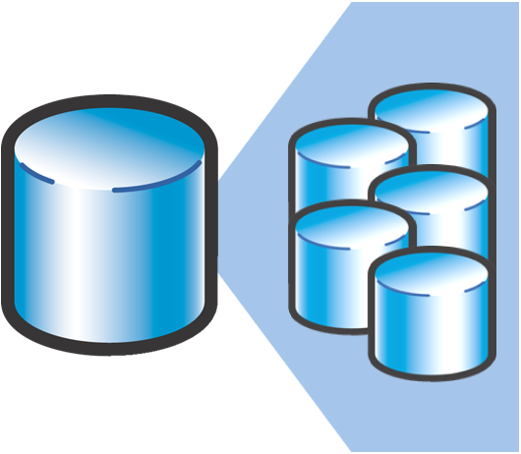

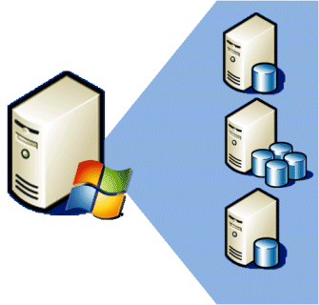
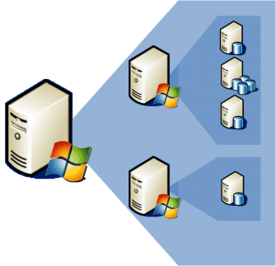
Forms of SQL Server Consolidation
There are four main options for using SQL Server 2008 as a platform for consolidation:
Multiple databases consolidated into a single database
Multiple databases consolidated to a SQL Server 2008 instance
Multiple SQL Server 2008 instances per physical server
Multiple virtual machines per physical server (virtualization)
Notes:
Multiple Databases Consolidated to a Single Database
In some cases, it may be possible to consolidate multiple databases into a single database in a single instance
For example, separate departmental databases could be subsumed into a single database, assuming that there are no operational or security barriers to prevent this. Applications that query the existing databases will be able to query the consolidated database with, typically, minimal re-coding required. Maintaining just one database is generally simpler and more cost-effective than maintaining multiple databases because, typically, fewer servers are required, backup management can be simplified (although individual backups can take longer), and you can use Resource Governor to manage contention.
Multiple Databases Consolidated to a SQL Server 2008 Instance
Probably the simplest approach to consolidation is to use a single instance of SQL Server 2008 with multiple databases. This approach is suitable when all of your databases have similar security, manageability, and compatibility requirements, and your hardware can provide the required level of performance and scalability for the workloads that are generated in all of the databases. The benefits of this approach include lower licensing and administrative costs, because you need to license and manage only one instance. Also, because each SQL Server instance that you install requires its own resources in terms of memory, disk, and so on, running a single instance makes better use of the available hardware than running multiple instances.
The number of databases that you can host will be dictated in part by the available hardware and the edition of SQL Server 2008 that you are using. SQL Server 2008 Standard Edition supports up to 4 CPUs; SQL Server 2008 Enterprise Edition is limited only by the limitations of the host operating system. Within a single instance, you can use Resource Governor to prioritize workloads and to prevent queries that dominate resource consumption and deny access to CPU and memory resources to other applications.
Multiple SQL Server 2008 Instances per Physical Server
A single-instance, multiple-database strategy may not always be appropriate, for example, in situations where you have databases with different security, manageability, or compatibility requirements. When this is the case, you can obtain the required level of isolation by running multiple instances of SQL Server 2008 concurrently on a single server to consolidate your data services.
Security is tighter because each instance has its own set of services, and you can prevent users from accessing data not just by denying them access at the database level, but at the server instance level. Furthermore, the authentication mode for each instance (SQL Server and Microsoft Windows® or Windows only) can be configured separately. By selectively enabling features such as CLR integration on only the instances where they are required, you can maintain minimal surface area exposure. However, this strategy does not enable complete isolation, because the sysadmin role can still access all instances on the machine.
Using this strategy, administrative functions such as backups of system databases are also isolated, and you can use Resource Governor within each instance to manage resource allocation for that instance. Using multiple instances to consolidate puts greater strain on the server, because each instance has its own resource requirements and you must take account of this when assessing your hardware requirements.
The edition of SQL Server 2008 that you use will determine the maximum number of instances that you can host per server.
SQL Server 2008 Standard Edition = max. 16 instances*
SQL Server 2008 Enterprise Edition = max 50 instances*
*Depending upon available system resources and workload
Multiple Virtual Machines per Physical Server (Virtualization)
For complete isolation at the operating system level, you can use a virtualization technology such as Microsoft Windows Hyper-V to host multiple virtual database servers on a single physical server. By using Microsoft Windows Server 2008 with the Hyper-V role, you can install multiple virtual operating systems on one computer and each of these virtual operating systems can host multiple instances of SQL Server 2008. By consolidating using virtualization, you achieve a good level of isolation between databases with different workloads, security requirements, manageability requirements, or compatibility requirements. The benefits are that you minimize the number of servers and licenses required and simplify the network infrastructure.
The hard disks of each virtual machine (VM) exist either as VHD files on the host operating system, which makes them very easy to back up and move to other servers, or as pass-through disks, which are physical disks that are allocated for the sole use of the virtual machine, and which provide excellent I/O performance. VMs provide an ideal environment for development and testing, because you do not need to maintain test environments that consist of multiple physical servers, and deployment to a live environment is simplified.
While you can install any edition of SQL Server in a VM, the licensing condition for SQL Server 2008 Enterprise Edition enables you to purchase one Windows license and one SQL Server license for each physical processor on the server, and run an unlimited number of VMs, each of which can host one or more SQL Server 2008 instances. This makes it possible for a single powerful server to host as many SQL Server instances as you require, and to add instances to it in the future without incurring extra licensing costs.
You can migrate VMs between physical servers quickly and easily, and with minimal downtime. This enables administrators to improve performance by making optimal use of server resources, to scale databases as required, and to perform scheduled maintenance, all with little or no impact on users. Windows Server 2008 R2 Hyper-V offers two mechanisms for migrating VMs: Quick Migration and Live Migration. Quick migration involves saving, moving, and restoring a VM to a new machine, and its use will usually involve a short period of downtime. Live migration enables the migration of VMs with virtually no downtime using a “memory to memory” operation. You can use Live Migration with both VHDs and network-attached pass-through disks.
Virtualization places a greater strain on servers than a simpler single or multiple instance strategy, and you need to carefully assess the impact of each virtual machine in terms of the resources it will consume. The AMD-V and Intel VT processor architectures that Windows Hyper-V leverages are designed specifically for virtualization, and they minimize the impact that running virtual machines has on a system.

Slide 50
Forms of SQL Server Consolidation
Multiple Instance
Since 2000 we have the ability to support multiple instances of SQL Server on a single Windows Server.
Security concerns can be addressed by this method allowing for example an instance of SQL Server to be created for databases which need SQL Authentication for certain applications to be created while another instance can be created for just Windows Authentication. Service pack levels can differ between the instances as well.
This means that now old SQL Servers in the environment being kept for a legacy application which needs SA rights can be moved to an instance on an existing SQL Server and we can remove the old SQL Server.
MDAC considerations have to be made for older applications allowing them to access named instances.

Slide 51
Forms of SQL Server Consolidation
Server Consolidation
Many SQL Servers are under utilized in environments. Sometimes an application was given a dedicated SQL Server and later it was discovered that this was no longer required for a variety of reasons – these SQL Servers could be decommissioned and the databases hosted on them moved to a shared SQL Server.
Virtualization
Sometimes it may be possible to replace a physical SQL Server or a number of them with a Virtual SQL Server. This would save hardware costs and although it may not reduce the installed SQL Servers in out environment and therefore licenses it does save on other costs.

Slide 52
Identifying potential consolidation candidates
Benchmark performance
Microsoft IT uses the following criteria to qualify candidate SQL Server instances for migration:
Permafrost or cold SQL Server instances running on a physical host
EOL servers that need replacement
End-of-warranty services that can be migrated
Net new servers (for example, new applications that require a database server)
Proactive migrations to take advantage of Hyper-V benefits and reduce costs
Server temperature | Mean CPU percentage | Maximum CPU percentage
Permafrost | ≤1 | ≤5
Cold | ≤5 | ≤20
Warm | ≤20 | ≤50
Hot | >20 | >50

Slide 53
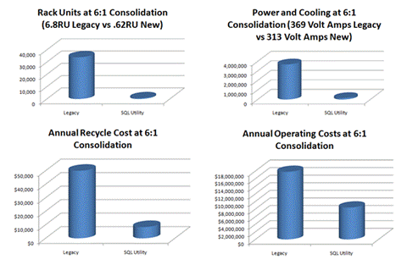
Microsoft IT - SQL Server Consolidation
http://technet.microsoft.com/en-us/library/dd557540.aspx
Notes:
The current Microsoft IT application portfolio consists of about 1,300 applications. Today, more than 4,700 SQL Server instances with about 100,000 databases on dedicated hosts support the Microsoft application portfolio.
Business units within Microsoft typically purchase dedicated hosts for their data-related application needs. However, data gathered from the RightSizing initiative indicates that the mean processor utilization across these hosts is below 10 percent. The underutilization of hardware taxes data-center resources such as space, power consumption, and cooling needs.
The cost of providing manageability and availability for single databases or instances is higher than that of a standardized and virtualized approach. Such an approach offers significant opportunity to provide a highly manageable and available solution at scale for minimal expense. In addition to providing virtualization, one such opportunity is to establish a standard library of server builds and an approach for replacing the current manual build process of development, test, and production environments. Microsoft IT can use this pattern for SQL Server, as well as for other types of servers and applications, to further reduce operating expenses.
This slide shows the effects of a 6-to-1 consolidation ratio as they pertain to resources. This ratio is an average that represents the savings that Microsoft IT found by consolidating resources. For example, where servers would have previously taken 6.8 rack units (RU), consolidation can provide the same computing and database resources in 0.62 RU.

Slide 54
Consolidation Considerations / Observations
Code re-write
MDAC compatibility
Connection strings
Overloading
Dependant objects
Microsoft Assessment and Planning Toolkit
Test – Test –Test
Notes:
Any migration to a newer version of SQL Server may require code changes, also any migration to a new SQL Server in general may require code rewrite both at application and T-SQL levels if hard coded paths are included for example.
MDAC considerations need to be made if using multiple instances to consolidate SQL Server databases as only from MDAC version 2.6 are named instances allowed from connections.
Any connection strings either in code or in DSN Connections for example will have to be changed if databases are migrated.
Be careful not to go from a situation where you have a number of under utilized SQL Servers to placing them all on one “big new” SQL Server – carefully monitor the usage as instances and databases are added to the migration destination SQL Server and make sure not to overload this system also take in count future predicted growth.
Seems obvious but - All dependant objects must also be migrated as well as databases - so jobs, SQL logins, linked Servers etc must all be accounted for.
Test – Test – Test – As usual….. Test the migration and test again before migrating production. Also test by off-lining a database for a period before decommissioning the server in case there are rogue connections to the SQL Server not noted in previous observations.

Slide 55
Additional References
Server Consolidation with SQL Server 2008
http://www.microsoft.com/sqlserver/2008/en/us/wp-sql-2008-server-consolidation.aspx
Microsoft Assessment and Planning Toolkit
http://www.microsoft.com/downloads/details.aspx?FamilyID=67240b76-3148-4e49-943d-4d9ea7f77730&displaylang=en
SQL Server Consolidation at Microsoft
http://technet.microsoft.com/en-us/library/dd557540.aspx
Reduce Costs and Deliver Value
http://www.microsoft.com/sqlserver/2008/en/us/spotlight-on-cost.aspx
SQL Server Consolidation
http://www.microsoft.com/sqlserver/2008/en/us/server-consolidation.aspx
Planning for Consolidation with SQL Server 2000
http://technet.microsoft.com/en-us/library/cc966486.aspx
Blog: SQL Server 2008 Consolidation and Virtualization at UBS
http://blogs.msdn.com/neilhut/archive/2008/08/25/sql-server-2008-consolidation-and-virtualization-at-ubs.aspx

Slide 56
Questions and (hopefully) Answers ☺
Q&A

Slide 57



Thank You!
Thanks for:
Your attention
Your support and
Your time

Slide 58
Disclaimer
The information contained in this slide deck represents the current view of Microsoft Corporation on the issues discussed as of the date of publication. Because Microsoft must respond to changing market conditions, it should not be interpreted to be a commitment on the part of Microsoft, and Microsoft cannot guarantee the accuracy of any information presented after the date of publication.
This slide deck is for informational purposes only. MICROSOFT MAKES NO WARRANTIES, EXPRESS, IMPLIED OR STATUTORY, AS TO THE INFORMATION IN THIS DOCUMENT.
Complying with all applicable copyright laws is the responsibility of the user. Without limiting the rights under copyright, no part of this slide deck may be reproduced, stored in or introduced into a retrieval system, or transmitted in any form or by any means (electronic, mechanical, photocopying, recording, or otherwise), or for any purpose, without the express written permission of Microsoft Corporation.
Microsoft may have patents, patent applications, trademarks, copyrights, or other intellectual property rights covering subject matter in this slide deck. Except as expressly provided in any written license agreement from Microsoft, the furnishing of this slide deck does not give you any license to these patents, trademarks, copyrights, or other intellectual property.
Unless otherwise noted, the example companies, organizations, products, domain names, e-mail addresses, logos, people, places and events depicted herein are fictitious, and no association with any real company, organization, product, domain name, email address, logo, person, place or event is intended or should be inferred.
© 2009 Microsoft Corporation. All rights reserved.
Microsoft, SQL Server, Office System, Visual Studio, SharePoint Server, Office PerformancePoint Server, .NET Framework, ProClarity Desktop Professional are either registered trademarks or trademarks of Microsoft Corporation in the United States and/or other countries.
The names of actual companies and products mentioned herein may be the trademarks of their respective owners.

Slide 59

© 2008 Microsoft Corporation. All rights reserved. Microsoft, Windows, Windows Vista and other product names are or may be registered trademarks and/or trademarks in the U.S. and/or other countries.
The information herein is for informational purposes only and represents the current view of Microsoft Corporation as of the date of this presentation. Because Microsoft must respond to changing market conditions, it should not be interpreted to be a commitment on the part of Microsoft, and Microsoft cannot guarantee the accuracy of any information provided after the date of this presentation. MICROSOFT MAKES NO WARRANTIES, EXPRESS, IMPLIED OR STATUTORY, AS TO THE INFORMATION IN THIS PRESENTATION.

